Slide 1
Bike Sharing Excel Data weather
Insights .. Master Data
Merge Data Clean Data

Slide 2
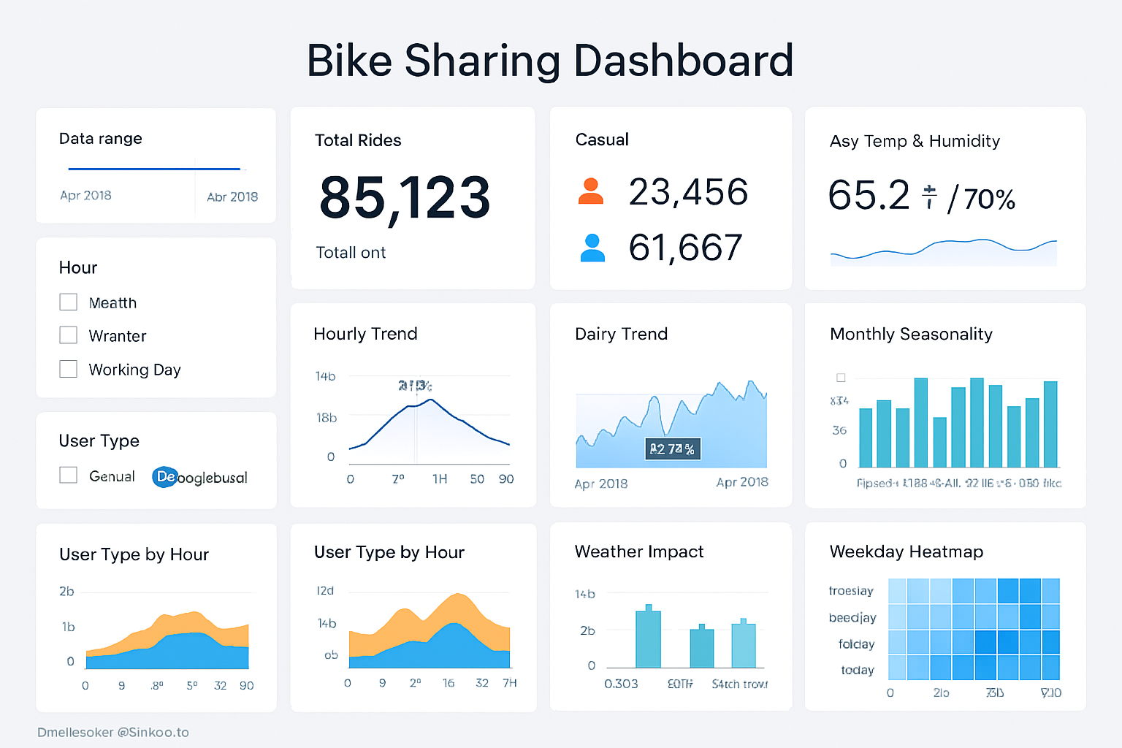

Slide 3
Duplicates & Data Cleaning
Duplicates removed: Check if the same rows exist in both files (e.g., same ID or key column).
  Insight: Redundant records can inflate totals or skew averages. Removing duplicates gives accurate counts.
Blank rows or columns removed: Ensures only meaningful data is analyzed.
  Insight: Any missing data might indicate incomplete records or data entry issues.

Slide 4
Key Metrics to Analyze
After merging the datasets:
Total rows: Compare before and after cleaning to see how many duplicates or blank rows were removed.
  Insight: High number of duplicates → data entry or reporting problem.
Unique IDs / keys: Count unique values in your key column (e.g., customer ID, product ID).
  Insight: How many unique entities exist; can reveal coverage of your data.
Missing values: Count nulls per column.
  Insight: Columns with high nulls may need imputation or indicate incomplete tracking.

Slide 5
    Before & after cleaning (duplicates removed, blank rows removed)
Key summary metrics per column
Suggested pivot table or chart ideas for visualization

Slide 6
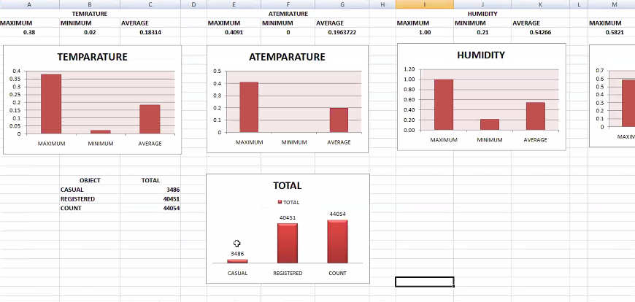

Slide 7
